Slide 1

Image Restoration AI
Syed Sirajuddin, Ian Rebmann, Carlos Ortiz, Tadbhir Singh
University of San Diego
AAI-521: Applied Computer Vision for AI
Dr. Roozbeh Sadeghian
December 7, 2025

Slide 2
Table Of Contents
Computer Vision Tasks
Colorization
Super Resolution
Inpainting
Denoising

Slide 3

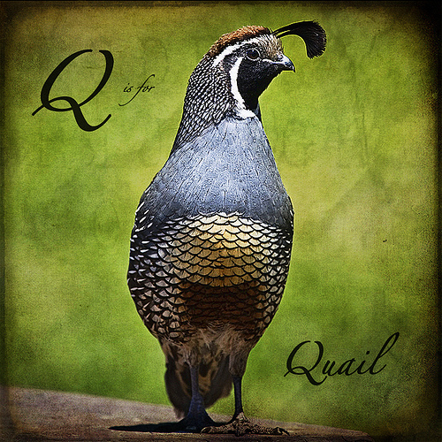
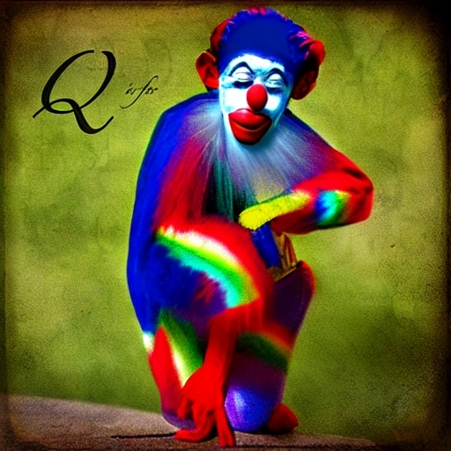
Diffusion-Based Image Inpainting with LoRA Fine-Tuning
Goal: restore missing/damaged regions seamlessly
Prioritized realistic, human-believable results
Secondary goal: reduce hallucinated text/labels/watermarks
Compared:
Base Stable Diffusion v1.5 Inpainting
LoRA-adapted variant

Slide 4
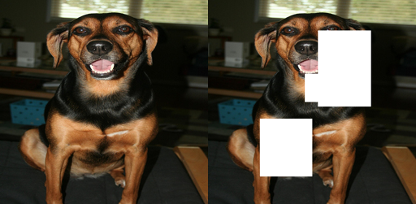
Controlled Damage + Masked Metrics
Dataset structure:
original / damaged / mask aligned by filename
resized to 512×512
Synthetic damage regimes:
Small masks: ~0.05–0.15 image size
Large masks: ~0.10–0.40 image size
Metrics:
Masked PSNR & Masked SSIM (primary)
Global PSNR/SSIM (secondary)

Slide 5
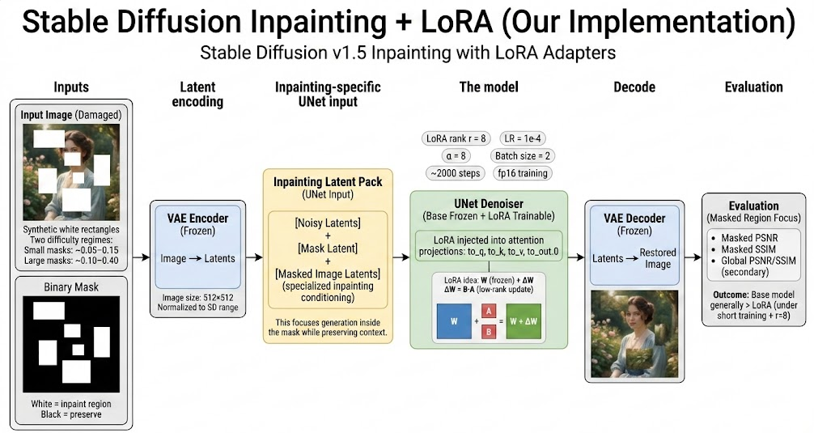
Architecture & Training Strategy
Latent diffusion pipeline
VAE encodes image → latents
Text encoder → prompt embeddings
UNet denoises across schedule
Inpainting UNet input is 9-channel
4 noisy latents + 1 mask + 4 masked-image latents
LoRA applied to attention
target modules: to_q, to_k, to_v, to_out.0
VAE + text encoder + base UNet weights frozen

Slide 6
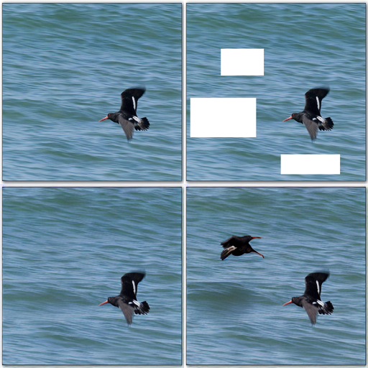
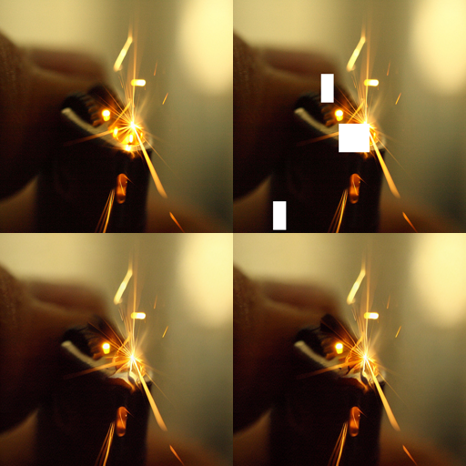
What We Found & What We’d Improve
Small masks
LoRA win-rate: PSNR 32%, SSIM 25%
Base mean masked PSNR 17.998 vs LoRA 17.541
Large masks
LoRA win-rate: PSNR 26%, SSIM 25%
Base mean masked PSNR 13.963 vs LoRA 12.919
Large Masks
Small Masks
Interpretation:
Base model already strong
LoRA likely underpowered for large-region priors
Metrics may understate perceptual quality
Future improvements:
formal train/val/test split
mix small + large + irregular masks
test higher LoRA rank (16–32) + longer training
stratify results by mask area %
Top-left: original | Top-right: damaged | Bottom-left: base | Bottom-right: LoRA

